Slide 1
Lecture 1: Fundamentals of Programming

Slide 2

What is an Algorithm?

Slide 3
What is an Algorithm?
How to prepare a birthday cake?
Mix the ingredients
Bake
Topping
Putting the candles

Slide 4
What is an Algorithm?
How to prepare a birthday cake?
Mix the ingredients
Bake
Topping
Putting the candles
Objects:
Flour
Eggs
Milk
Oil
Choc
Baking Powder
Sugar
Procedures
Mix the dry ingredients in a bow
Break the eggs and stir with the milk and oil
…

Slide 5
What is an Algorithm?
“A finite, well-defined, step-by-step method that contains inputs and outputs and guarantees the solution to a problem when followed strictly”
“Introduction to Algorithms” by Thomas H. Cormen, Charles E. Leiserson, Ronald L. Rivest and Clifford Stein (MIT press)

Slide 6
Is every program an Algorithm?

Slide 7
Coding Sequences
Algorithm — a finite, well-defined, step-by-step method that contains inputs and outputs and guarantees the solution to a problem when followed strictly. [Sources: CLRS (MIT Press); Britannica]
Procedure/Subroutine; Function/Method — a callable unit of code. Many languages distinguish procedures (no return value) from functions (return a value); in OO contexts, class-bound functions are methods. [Sources: Wikipedia (Function in programming); Loyola Marymount University notes]
Process (Operating System) — an instance of a running program with its own memory and state, managed by the OS (PID, scheduling, lifecycle). [Source: Baeldung — Process Lifecycle]
Software Process / SDLC — a structured methodology for planning, building, testing, deploying, and maintaining software (e.g., waterfall, agile). [Sources: IBM SDLC; Microsoft Power Platform SDLC overview]
Pseudocode — a language-agnostic, human-readable description of an algorithm using programming-like constructs, intended for design and communication rather than execution. [Sources: Wikipedia — Pseudocode; GeeksforGeeks tutorial]
Flowchart — a graphical representation of control flow (start/end, process, decision, I/O) using standardized symbols; ISO 5807 defines symbols and conventions. [Sources: ISO 5807; Venngage symbols guide]
Heuristic — a problem-solving technique that trades optimality or completeness for speed, aiming for “good enough” solutions efficiently (e.g., A* with admissible heuristic). [Sources: Wikipedia — Heuristic (CS); Baeldung — Heuristic function]

Slide 8
Coding Sequences
Algorithm — a finite, well-defined, step-by-step method that contains inputs and outputs and guarantees the solution to a problem when followed strictly. [Sources: CLRS (MIT Press); Britannica]
Procedure/Subroutine; Function/Method — a callable unit of code. Many languages distinguish procedures (no return value) from functions (return a value); in OO contexts, class-bound functions are methods. [Sources: Wikipedia (Function in programming); Loyola Marymount University notes]
Process (Operating System) — an instance of a running program with its own memory and state, managed by the OS (PID, scheduling, lifecycle). [Source: Baeldung — Process Lifecycle]
Software Process / SDLC — a structured methodology for planning, building, testing, deploying, and maintaining software (e.g., waterfall, agile). [Sources: IBM SDLC; Microsoft Power Platform SDLC overview]
Pseudocode — a language-agnostic, human-readable description of an algorithm using programming-like constructs, intended for design and communication rather than execution. [Sources: Wikipedia — Pseudocode; GeeksforGeeks tutorial]
Flowchart — a graphical representation of control flow (start/end, process, decision, I/O) using standardized symbols; ISO 5807 defines symbols and conventions. [Sources: ISO 5807; Venngage symbols guide]
Heuristic — a problem-solving technique that trades optimality or completeness for speed, aiming for “good enough” solutions efficiently (e.g., A* with admissible heuristic). [Sources: Wikipedia — Heuristic (CS); Baeldung — Heuristic function]

Slide 9
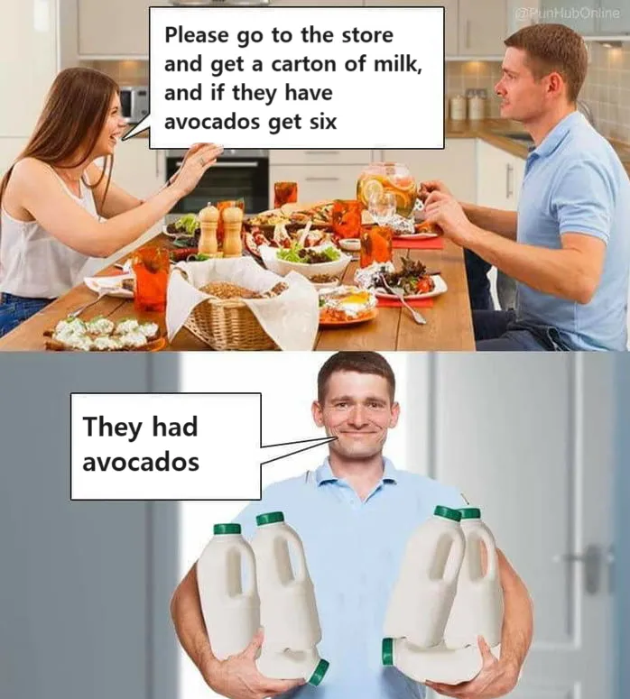
The “bad programmer” paradox

Slide 10
The “bad programmer” paradox
What type of logic is this?

Slide 11
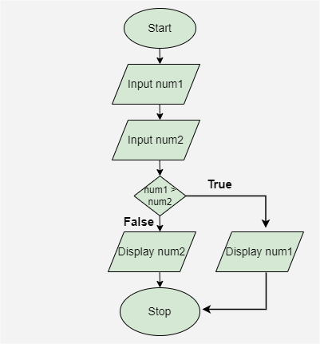
Flowchart
Definition: A graphical representation of control flow (start/end, processes, decisions, I/O) using standardized symbols.
Purpose: provide clarity and simplification to complex processes and algorithms.

Slide 12
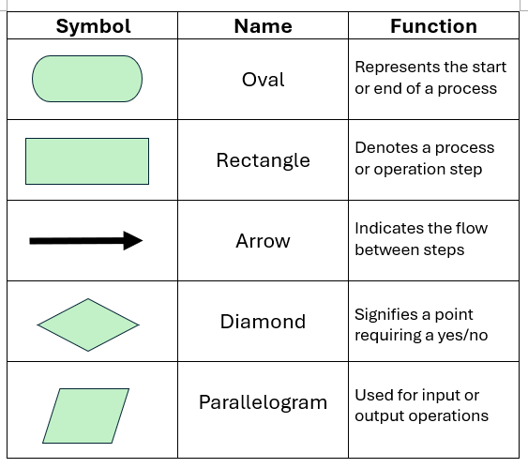
Flowchart

Slide 13

Flowchart example
Robot’s move:
Up
Down
Right
Left

Slide 14
Flowchart example
Start
Get direction
Move to direction
End

Slide 15
Flowchart: exercise
Now we have obstacles (dark cells).
Update the flowchart to check if the cell is free before moving.
Start
Get direction
Move to direction
End

Slide 16
Flowchart: exercise
Start
Now we have obstacles (dark cells).
Update the flowchart to check if the cell is free before moving.
Get direction
No
Is cell free?
Yes
Move to direction
End

Slide 17
Pseudocode
Definition: A language-independent way to describe algorithms using structured steps.
Purpose: Focus on logic, not syntax.
How to (pseudo)code:
Start with the goal of the algorithm as a comment
Use code ident for the blocks
Use “end” and the command to finish a block
Test your code for failures
// Calculate the factorial of n recursively
Algorithm Factorial(n)
if n = 0 then
return 1
else
return n * Factorial(n - 1)
end if
end algorithm

Slide 18
Pseudocode
Why to Use?
Language-independent
Improves clarity
Easier debugging
Facilitates communication
Serves as a blueprint for coding

Slide 19
Pseudocode
Token | Meaning | Example | Notes
← | Assignment (store right side into left side) | sum ← 0 | Text alternatives: <- or :=
= | Equality comparison | IF x = 10 THEN | Distinct from assignment
≠ | Not equal | IF x ≠ y THEN | Alternative: !=
<, ≤, >, ≥ | Comparisons | IF a ≤ b THEN | Standard math comparisons
AND, OR, NOT | Logical operators | IF a > 0 AND b > 0 THEN | Short-circuit logic as usual
[] | Indexing / list literal | A[0], A ← [1,2,3] | 0-based indexing in this handout
{} | Set or map literal | S ← {1,2,3} / M ← {k: v} | Context defines set vs map
… | Ellipsis (omitted steps) | // … | Use sparingly
: | Parameter labels / map keys | {x: 1, y: 2} | Also used in messages
NIL | No value / null | IF node = NIL THEN … | For absence
// | Comment | // explain logic here | Everything after // is ignored

Slide 20
Pseudocode example
Robot’s move:
Up
Down
Right
Left

Slide 21
Pseudocode example
Robot’s move:
Up
Down
Right
Left
Question:
Does high level descriptions work when translating to actual code?

Slide 22
Scenario
Map:3x3 Grid
[0][0] | [0][1] | [0][2]
[1][0] | [1][1] | [1][2]
[2][0] | [1][2] | [2][2]
Wall/Obstacle
Map[i][j]=0
Free path
Map[i][j]=1

Slide 23
Scenario
Robot’s move:
Up
Down
Right
Left
robot position = [1][1]
move(down)
robot position = ?

Slide 24
Scenario
Robot’s move:
Up
Down
Right
Left
robot position = [1][1]
move(down)
robot position = [2][1]
Let’s call it robot_position.x and robot_position.y

Slide 25
Pseudocode exercise/example:
robot_position{robot_position.x, robot_position.y} -> SET
Implement the function “move(direction, robot_position)” that will return the updated position of the robot (robot_position.x, robot_position.y) given a direction (up,down,right, left) and the current position.

Slide 26
Pseudocode exercise/example:
Implement the function “move(direction, robot_position)” that will return the updated position of the robot (robot_position.x, robot_position.y) given a direction (up,down,right, left) and the current position.
// calculate the new position based on current position and direction to move
Move (direction, robot_position)
if direction = “up”
robot_position.y ← robot_position.y - 1
return robot_position
else if direction = “down”
robot_position.y ← robot_position.y + 1
return robot_position
else if direction = “right”
robot_position.x ← robot_position.x + 1
return robot_position
else if direction = “left”
robot_position.x ← robot_position.x - 1
return robot_position
end if
end algorithm

Slide 27
Pseudocode exercise:
Implement the complete pseudocode for the robot to move, checking valid cells.

Slide 28

Coding tips
Always start with the simple cases
Write it clear
Check the edge cases
Go for a flowchart if you get stuck
Talk to your peers
Think about cracking the code

Slide 29

MATLAB

Slide 30
MATLAB (MATrix LABoratory):
A powerful, proprietary programming language and numeric computing environment
Array-first, 1-based indexing:
Prefers vectorization over loops when possible, and preallocate in loops to avoid dynamic resizing (Creating arrays first than iterating).
To use it:
https://uk.mathworks.com/products/matlab.html and download it
Or create an account and use it online at https://matlab.mathworks.com/

Slide 31
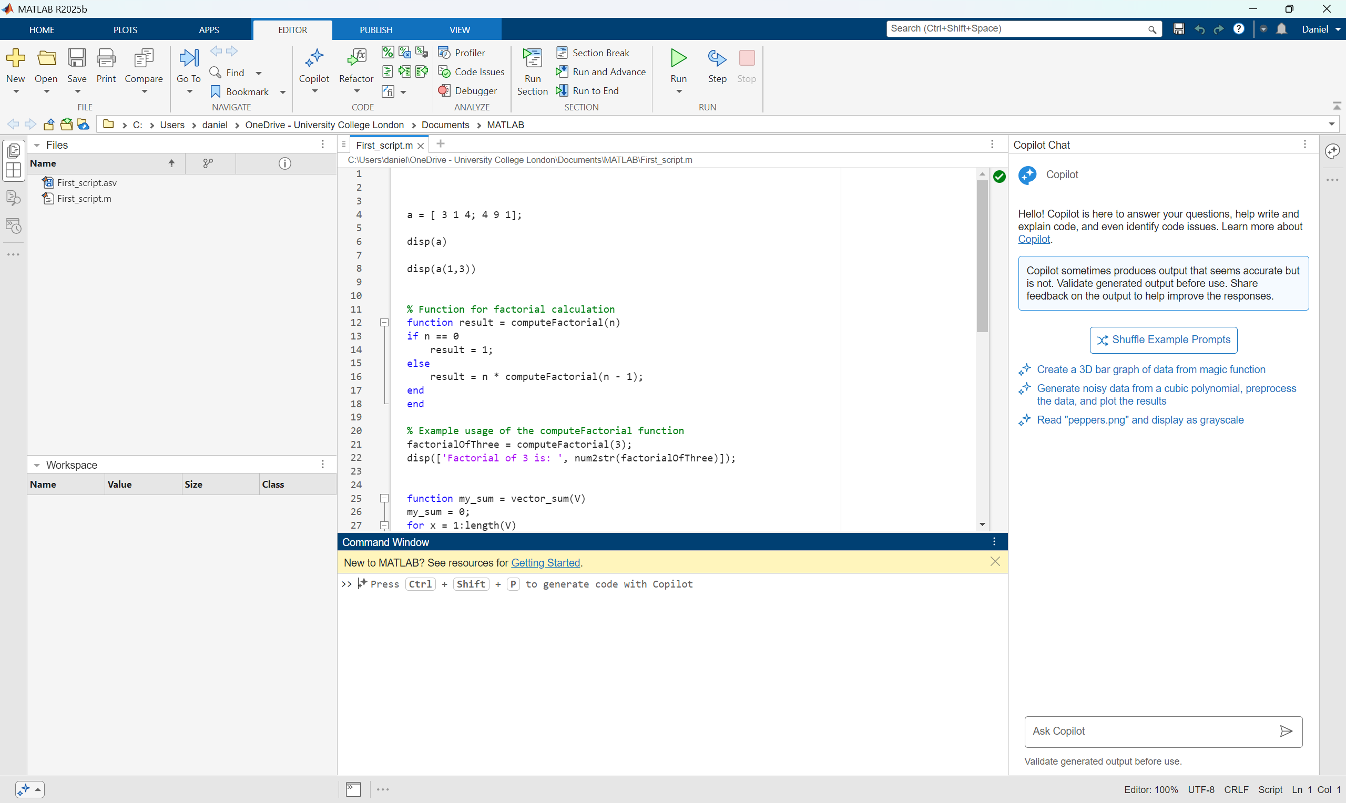
IDE

Slide 32
MATLAB Fundamentals:
Semicolon (;) to finish lines
Keyword “end” to finish blocks
Function “disp()” to display
Scripts saved as <<file_name>>.m
No needs to initialized variables (weakly typed)

Slide 33
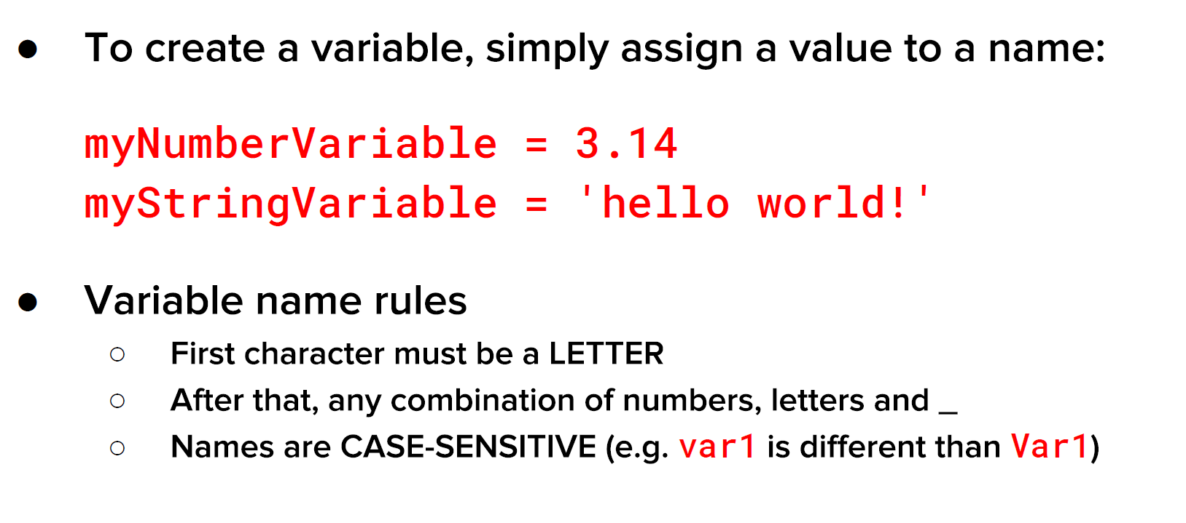
Naming Variables:

Slide 34
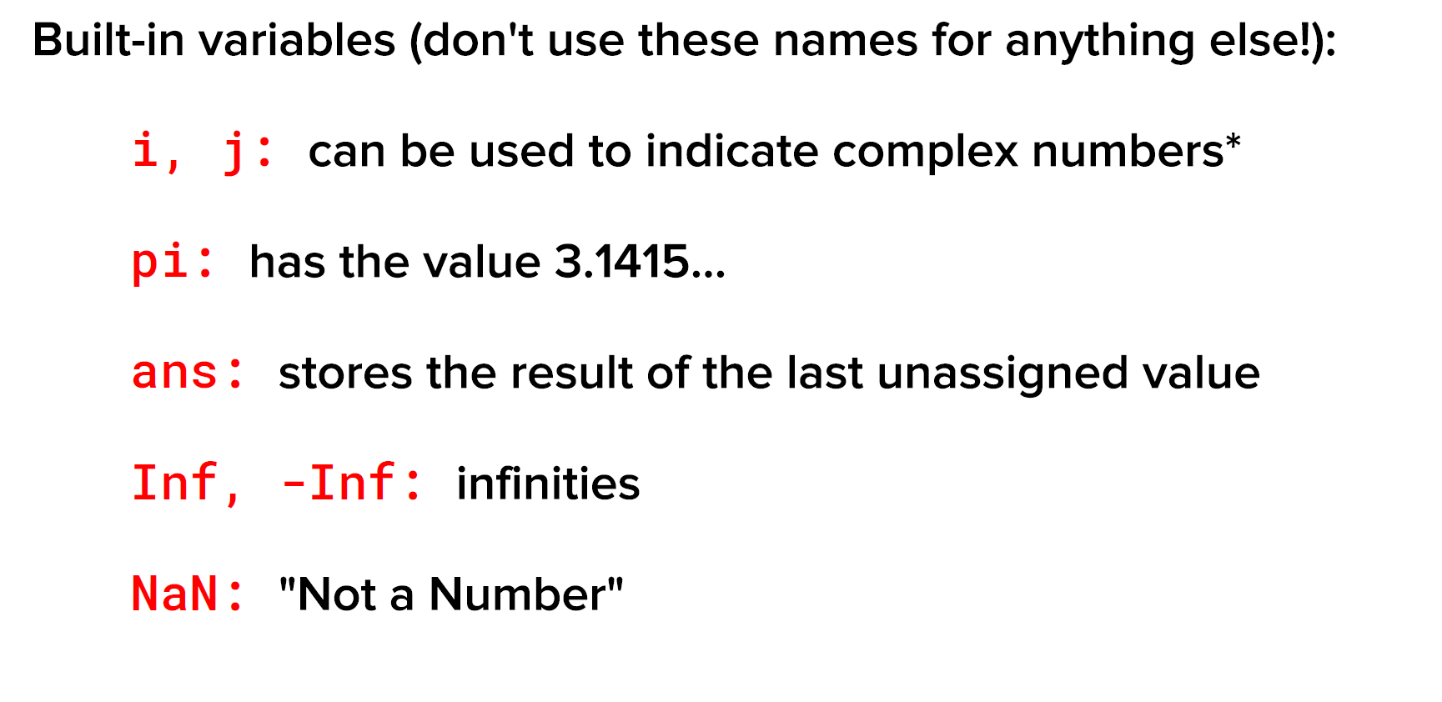
Naming Variables:

Slide 35
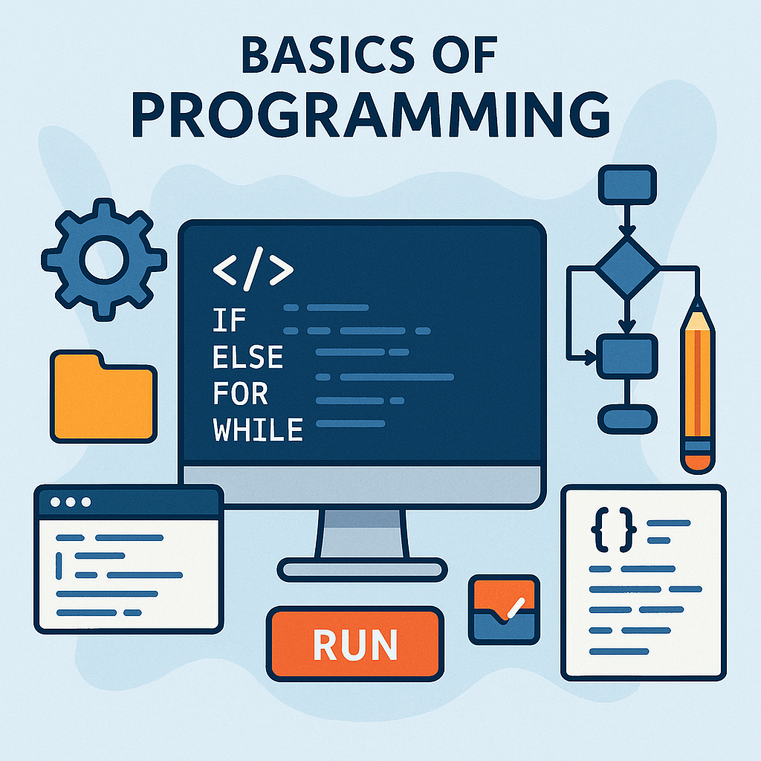
Programming, the basics

Slide 36
if / elseif / else — Branching
Use when:
You need to execute different blocks based on conditions.
The condition is a scalar logical (true/false). For array conditions, combine with any() or all().
Common pitfalls:
Using a vector or matrix directly in an if condition; wrap with any()/all() or use logical indexing.
Condition
Yes
No

Slide 37
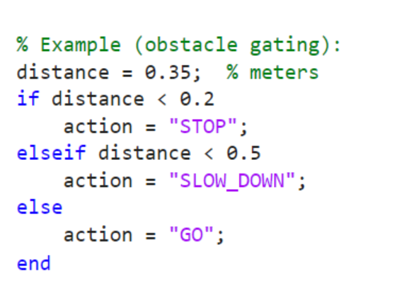
if / elseif / else — Branching
Yes
distance < 0.2
“STOP”
Yes
distance < 0.5
“SLOW”
No
“GO”

Slide 38
switch / case / otherwise — Discrete choices
Use when:
Selecting behaviour based on enumerated states or strings.
A long elseif chain harms readability.
Condition 1
Conditions
Condition 2
Condition 3
…
Condition n

Slide 39
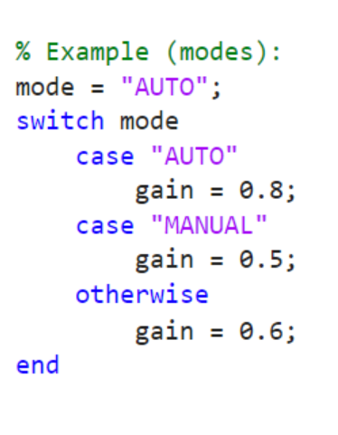
switch / case / otherwise — Discrete choices
Conditions
“AUTO”
gain = 0.8
“MANUAL”
gain = 0.5
None
gain = 0.6

Slide 40
switch / case / otherwise — Discrete choices
Conditions
“AUTO”
gain = 0.8
“MANUAL”
gain = 0.5
None
gain = 0.6
EXERCISE: Change this to an if/else grammar

Slide 41
FOR — Counted loops
counter > n?
Use when:
Iterating over a known range or array elements.
Each iteration may depend on the previous result.
You can preallocate the output array.
Pitfalls & tips:
Preallocate arrays: X = zeros(N,1) before the loop.
Prefer vectorization when the loop body is purely element-wise.
no
COMMAND
Increment counter

Slide 42
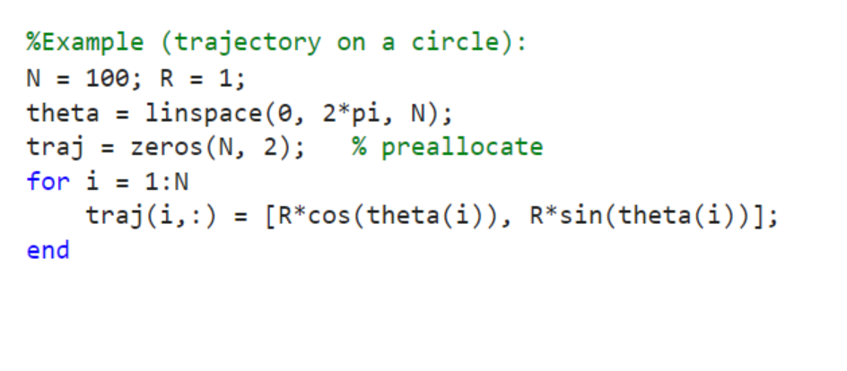
FOR — Counted loops
counter > n?
no
COMMAND
Increment counter

Slide 43
WHILE — Condition-driven loops
Yes
Condition?
Use when:
You do not know the number of iterations in advance.
You iterate until a convergence criterion or event occurs.
Pitfalls & tips:
Ensure the loop condition changes; add a safety cap (maxIter) to avoid infinite loops.
no
COMMAND

Slide 44
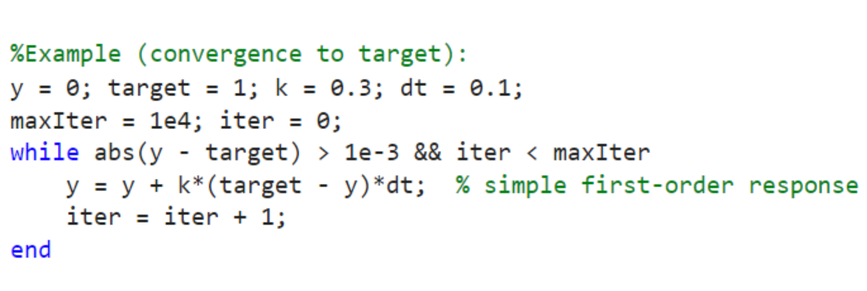
WHILE — Condition-driven loops
Yes
Condition?
no
COMMAND

Slide 45
BREAK / Continue — Early exit & skip
Yes
Condition 1?
No
Use when:
break to stop the loop early (found what you need).
continue to skip the remainder of the current iteration.
COMMAND
Yes
Condition 2?
BREAK
No

Slide 46
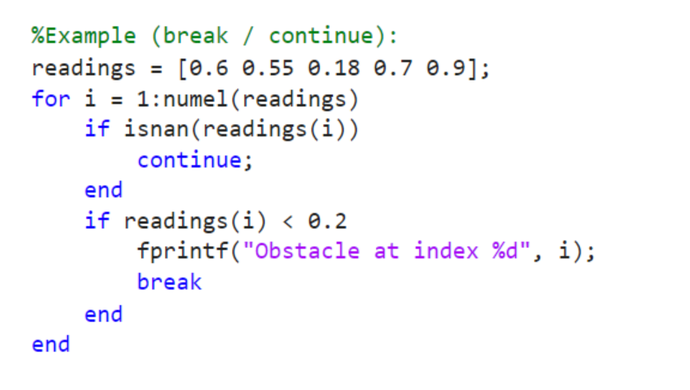
BREAK / Continue — Early exit & skip
Yes
Condition 1?
No
COMMAND
Yes
Condition 2?
BREAK
No

Slide 47
BREAK / Continue — Early exit & skip
Yes
Condition 1?
No
COMMAND
Yes
Condition 2?
BREAK
No

Slide 48
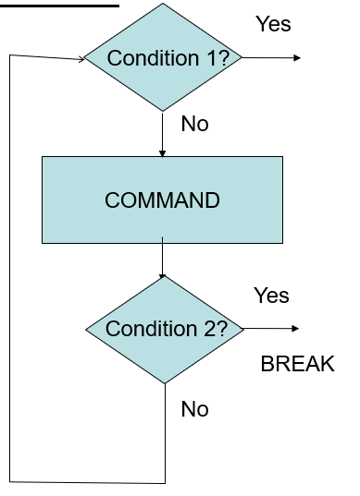
Functions — Encapsulation & reuse
Use when:
You want to reuse logic, write tests, and keep the workspace clean.
Prefer functions over scripts for assignments and projects
my_function

Slide 49
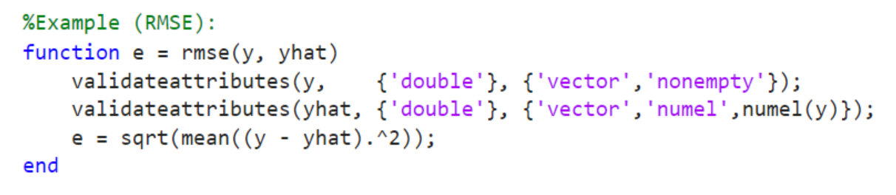
Functions — Encapsulation & reuse

Slide 50
Functions — Exercise
Write its flowchart as well
Write the following pseudocode in MATLAB:
// Calculate the factorial of n recursively
Algorithm Factorial(n)
if n = 0 then
return 1
else
return n * Factorial(n - 1)
end if
end algorithm
my_function

Slide 51
Basic Structure / Blocks

Slide 52
Advanced thinking
Dividing to conquer:
Always break your task in smaller tasks
Recursion
Use your separate the most you can of your function to reuse them inside themselves
Indexing
Use the indexes of the structures to beyond just the index function
Short-coding
Shrink your code to the minimum computation effort

Slide 53

Exercise sessions
Modelling the Robot/Maze

Slide 54
Scenario
Map:3x3 Grid
For pseudocode:
[0][0] | [0][1] | [0][2]
[1][0] | [1][1] | [1][2]
[2][0] | [1][2] | [2][2]
Wall/Obstacle
Map[i][j]=0
Free path
Map[i][j]=1

Slide 55
Scenario
Map:3x3 Grid
For MATLAB:
[1][1] | [1][2] | [1][3]
[2][1] | [2][2] | [2][3]
[3][1] | [3][2] | [3][3]
Wall/Obstacle
Map[i][j]=0
Free path
Map[i][j]=1

Slide 56
Exercise
Create the following scenario in MATLAB
[1][1] | [1][2] | [1][3]
[2][1] | [2][2] | [2][3]
[3][1] | [3][2] | [3][3]
Wall/Obstacle
Map[ii][jj]=0
Free path
Map[ii][jj]=1

Slide 57
Exercises session 1
Create the following scenario in MATLAB
Create a matrix named map
Attribute the obstacle values
Create a function to print the map
Insert the robot:
Create another matrix [1,2] to store the robot position
Adapt the function of item 2 to print “R” where the robot is
Implement the function “move(direction, robot_pos)” to move the robot
Test your function with values hardcoded defined (meaning declaring the values in your code)
[1][1] | [1][2] | [1][3]
[2][1] |  | [2][3]
[3][1] | [3][2] | [3][3]

Slide 58
Exercises session 2
Implement the verifications in the functions implemented in Session 1:
Verify if the cell is free before moving
Verify whether the next move goes out of the map (edges)
Implement a function that given two numbers n and m, create a mesh map of size n*m with all the cells
Make sure your print_map function handles the new map
Adapt your code so you can take the next direction from the keyboard (users insert next direction)
[1][1] | [1][2] | [1][3]
[2][1] |  | [2][3]
[3][1] | [3][2] | [3][3]

Slide 59
Exercises session 3
Test your code in the following mesh maze (7x7):
Don’t forget to test the condition for out of map (successfully exited)
Modify your code to search for the exit autonomously (checking all the directions)
Cells to start
[6][2]
[4][4]
[2][6]
Work in pairs to handout tomorrow a best-solution for automatically scape the maze
 |  |  |  |  | [6][2]
 |  |  | [4][4]
 | [6][2]
exit

Slide 60

Thank you for your attention
Please leave your feedback.
Use the QR code or link:
SJTU Winter School- Tozadore Feedback – Fill in form

